Slide 1
Philippians 4:2-9
Living Heavenly Lives in an Earthly World
Dan Bridges Amman International Church, Jordan (AmmanChurch.org) Uploaded by Dr. Rick Griffith • Jordan Evangelical Theological Seminary Files in many languages for free download at BibleStudyDownloads.org

Slide 2
What are the Top Challenges in Your Life?
Conflict
Marriage
Child Raising
Friends
Discouragement / Depression
Work Difficulties
Financial Difficulties

Slide 3
How do we Deal with these Challenges?
Man’s way to deal with these:
Techniques and methods
God’s way to deal with these:
Apply powerful theological realities to everyday life

Slide 4
Powerful Theological Principles from Philippians
⁵ Have this mind among yourselves, which is yours in Christ Jesus. (2:5)
⁸ Indeed, I count everything as loss because of the surpassing worth of knowing Christ Jesus my Lord. (3:8)
²⁰ But our citizenship is in heaven, and from it we await a Savior, the Lord Jesus Christ… (3:20)
Powerful theological truths…
How do they apply in real life?

Slide 5
² I entreat Euodia and I entreat Syntyche to agree in the Lord. ³ Yes, I ask you also, true companion, help these women, who have labored side by side with me in the gospel together with Clement and the rest of my fellow workers, whose names are in the book of life.
Philippians 4:2-3

Slide 6
⁴ Rejoice in the Lord always; again I will say, rejoice. ⁵ Let your reasonableness be known to everyone. The Lord is at hand; ⁶ do not be anxious about anything, but in everything by prayer and supplication with thanksgiving let your requests be made known to God. ⁷ And the peace of God, which surpasses all understanding, will guard your hearts and your minds in Christ Jesus.
Philippians 4:4-7

Slide 7
⁸ Finally, brothers, whatever is true, whatever is honorable, whatever is just, whatever is pure, whatever is lovely, whatever is commendable, if there is any excellence, if there is anything worthy of praise, think about these things. ⁹ What you have learned and received and heard and seen in me—practice these things, and the God of peace will be with you.
Philippians 4:8-9

Slide 8
Living Heavenly Lives in an Earthly World
Big truths applied to:
Conflict (2-3)
Mental Health/Stability (4)
Times of Anxiety (6-9)

Slide 9
Conflict
² I entreat Euodia and I entreat Syntyche to agree in the Lord. ³ Yes, I ask you also, true companion, help these women, who have labored side by side with me in the gospel together with Clement and the rest of my fellow workers, whose names are in the book of life.
Philippians 4:2-3

Slide 10
Who was in Conflict?
² I entreat Euodia and I entreat Syntyche to agree in the Lord. ³ Yes, I ask you also, true companion, help these women, who have labored side by side with me in the gospel together with Clement and the rest of my fellow workers, whose names are in the book of life.
Philippians 4:2-3
Notes:
Two mature believers are in conflict

Slide 11
What was the Conflict About?
² I entreat Euodia and I entreat Syntyche to agree in the Lord. ³ Yes, I ask you also, true companion, help these women, who have labored side by side with me in the gospel together with Clement and the rest of my fellow workers, whose names are in the book of life.
Philippians 4:2-3
It doesn’t seem to matter!
It doesn’t seem to be a critical doctrinal error
Important thing is the effect of the conflict on the Philippian church

Slide 12
Handling Conflict in a Christlike Way
² I entreat Euodia and I entreat Syntyche to agree in the Lord. ³ Yes, I ask you also, true companion, help these women, who have labored side by side with me in the gospel together with Clement and the rest of my fellow workers, whose names are in the book of life.
Philippians 4:2-3
Both sides must take responsibility
Having the mind of Christ
(selflessness and humility)
Notes:
Two mature believers are in conflict

Slide 13
Handling Conflict in a Christlike Way
² I entreat Euodia and I entreat Syntyche to agree in the Lord. ³ Yes, I ask you also, true companion, help these women, who have labored side by side with me in the gospel together with Clement and the rest of my fellow workers, whose names are in the book of life.
Philippians 4:2-3
Involve Christ in it!
Notes:
Word for “agree” is also used in 2:2 – translated as “of the same mind”

Slide 14
Handling Conflict in a Christlike Way
“Agree” translated in 2:2 as “same mind”
² I entreat Euodia and I entreat Syntyche to agree in the Lord. ³ Yes, I ask you also, true companion, help these women, who have labored side by side with me in the gospel together with Clement and the rest of my fellow workers, whose names are in the book of life.
Philippians 4:2-3
Apply attitudes of Philippians 2:2-8
Is conflict due to rivalry or conceit?
Am I counting them more significant than me?
What are their/God’s interests in this?
Notes:
Word for “agree” is also used in 2:2 – translated as “of the same mind”

Slide 15
Handling Conflict in a Christlike Way
² I entreat Euodia and I entreat Syntyche to agree in the Lord. ³ Yes, I ask you also, true companion, help these women, who have labored side by side with me in the gospel together with Clement and the rest of my fellow workers, whose names are in the book of life.
Philippians 4:2-3
Have the humility to get outside help!
Notes:
Word for “agree” is also used in 2:2 – translated as “of the same mind”

Slide 16
Conflict – Why does Resolving it Matter?
Who does the conflict affect?
You
The person/people you’re in conflict with
The people around you who are observing it
The body of Christ
Unbelievers – hurts message of the Gospel
Are you willing to view your conflict as God views it?

Slide 17
Living Heavenly Lives in an Earthly World
Big truths applied to:
Conflict (2-3)
Mental Health/Stability (4)
Times of Anxiety (6-9)

Slide 18
Mental Health/Stability
Meaning: Be continually rejoicing!
Rejoice in the Lord always; again I will say, rejoice. Philippians 4:4
Notes:
Whatever this is must apply to all personalities, to all cultures and to all circumstances…

Slide 19
Does this mean we must always be happy?
How can an emotion be commanded?
Rejoice:
Emotion felt when you feel like things are working out
Wisemen’s joy at seeing the star
Disciples’ joy upon realizing Jesus was alive
What we’ll feel when Jesus’ glory is revealed (Genuine gladness and joy!)

Slide 20
Does this mean we must always be happy?
This joy is not in our circumstances
It is based on our relationship with Christ
Rejoice in the Lord always; again I will say, rejoice. Philippians 4:4

Slide 21
The Role of Identity
Identity: The thing in life from which we get our value; what we love most
I feel good about myself if:
Someone loves me
My career is going well
I’m financially secure

Slide 22
The Role of Identity
What we find our identity in will determine our degree of joy in any situation…
Example: A woman gets engaged and then loses her job the next day – how does she feel about the job loss?

Slide 23
Does this mean we must always be happy?
Finding our identity in anything earthly means it’s attached to something that won’t last.
Rejoicing in the Lord does not mean we’re always emotionally “happy”.
It does mean we go through life with a deep sense that life is okay – that it’s working out!
Rejoicing in the Lord means making him our identity.
If my relationship with him is okay, then life is okay!

Slide 24
How do we Make Christ Our Identity?
To make Christ our Identity, we must see ourselves through God’s eyes…
Who am I in Christ?
What do I have in Christ?
What will I experience in Christ?

Slide 25
Identity in Christ from Ephesians
In Christ I am…
Chosen (Eph 1:4)
Adopted as God’s child (Eph 1:5)
Loved (Eph 2:4)
God’s workmanship (Eph 2:10)

Slide 26
Identity in Christ from Ephesians
In Christ I have…
Every spiritual blessing (Eph 1:3)
Forgiveness of my sins (Eph 1:7)
God’s power at work in my life (Eph 1:19)
Spiritual life (Eph 2:5)

Slide 27
Identity in Christ from Ephesians
In Christ I will one day experience…
Perfect holiness (Eph 1:4)
A glorious inheritance (Eph 1:11,18)
Being for the “praise of his glory” (Eph 1:12)

Slide 28
How do we Make Christ Our Identity?
To make Christ our Identity, we must see ourselves through God’s eyes…
Who am I in Christ?
What do I have in Christ?
What will I experience in Christ?
The degree to which I believe these truths in my heart of hearts is the degree to which I can rejoice in the Lord!
Are you willing to pursue rejoicing in the Lord?

Slide 29
What about depression?
We must recognize that it’s a reality
It can be common among cross-cultural workers – stress of relating, feelings of incompetence, loss of familiar identity
Notes:
Whatever this is must apply to all personalities, to all cultures and to all circumstances…

Slide 30
What about depression?
It doesn’t mean you’re a bad Christian!
It’s nothing to be ashamed of
It probably means you are under more significantly more stress than normal
Notes:
Whatever this is must apply to all personalities, to all cultures and to all circumstances…

Slide 31
What about depression?
It does need to be addressed!
It does mean you need community
It may mean you need counseling or other professional help – that’s okay
Are we ready to help each other in this area?
Notes:
Whatever this is must apply to all personalities, to all cultures and to all circumstances…

Slide 32
Living Heavenly Lives in an Earthly World
Big truths applied to:
Conflict (2-3)
Mental Health/Stability (4)
Times of Anxiety (6-9)

Slide 33
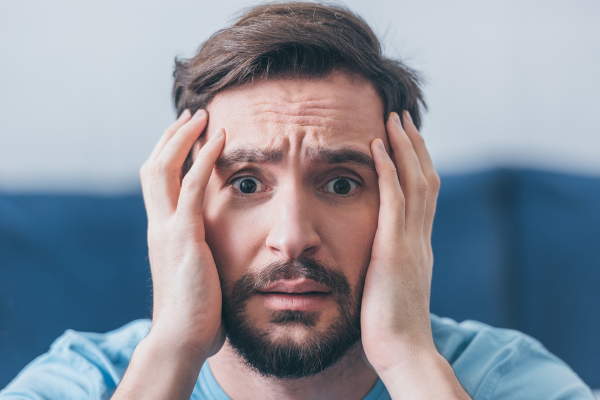
Times of Anxiety
⁶ do not be anxious about anything, but in everything by prayer and supplication with thanksgiving let your requests be made known to God. ⁷ And the peace of God, which surpasses all understanding, will guard your hearts and your minds in Christ Jesus.
Philippians 4:4-7
How realistic is this???

Slide 34
Times of Anxiety
⁶ do not be anxious about anything, but in everything by prayer and supplication with thanksgiving let your requests be made known to God. ⁷ And the peace of God, which surpasses all understanding, will guard your hearts and your minds in Christ Jesus.
Philippians 4:4-7
Clear action plan in times of anxiety

Slide 35
Times of Anxiety
God is the one who removes our symptoms of anxiety!
⁶ do not be anxious about anything, but in everything by prayer and supplication with thanksgiving let your requests be made known to God. ⁷ And the peace of God, which surpasses all understanding, will guard your hearts and your minds in Christ Jesus.
Philippians 4:4-7

Slide 36
The Action Plan
⁶ do not be anxious about anything, but in everything by prayer and supplication with thanksgiving let your requests be made known to God. ⁷ And the peace of God, which surpasses all understanding, will guard your hearts and your minds in Christ Jesus.
Philippians 4:4-7
Prayer – Word for all of prayer including praise, worship, confession, thanksgiving and making requests

Slide 37
The Action Plan
⁶ do not be anxious about anything, but in everything by prayer and supplication with thanksgiving let your requests be made known to God. ⁷ And the peace of God, which surpasses all understanding, will guard your hearts and your minds in Christ Jesus.
Philippians 4:4-7
Thanksgiving – Both for past answers to prayer and also in trust for future answers to this prayer

Slide 38
The Action Plan
How can we thank God ahead of time when we don’t know how he is going to answer this prayer?
“God gives us what we would have asked for if we had known everything he knows!”
Dr. Timothy Keller

Slide 39
The Action Plan
⁶ do not be anxious about anything, but in everything by prayer and supplication with thanksgiving let your requests be made known to God. ⁷ And the peace of God, which surpasses all understanding, will guard your hearts and your minds in Christ Jesus.
Philippians 4:4-7
Supplication, Requests – Ask God, ask specifically, even when you can’t imagine how he’ll answer!

Slide 40
God’s Response
This is a PROMISE of God!
Peace replaces anxiety
This peace cannot be explained
It will “stand guard” over our hearts and minds, protecting us from anxiety
⁶ do not be anxious about anything, but in everything by prayer and supplication with thanksgiving let your requests be made known to God. ⁷ And the peace of God, which surpasses all understanding, will guard your hearts and your minds in Christ Jesus.
Philippians 4:4-7

Slide 41
God’s Response
⁶ do not be anxious about anything, but in everything by prayer and supplication with thanksgiving let your requests be made known to God. ⁷ And the peace of God, which surpasses all understanding, will guard your hearts and your minds in Christ Jesus.
Philippians 4:4-7
How are you doing at giving your anxieties to God in this way?

Slide 42
We put Big Truths in our Hearts by
First Putting them in our Minds!
⁸ Finally, brothers, whatever is true, whatever is honorable, whatever is just, whatever is pure, whatever is lovely, whatever is commendable, if there is any excellence, if there is anything worthy of praise, think about these things.
Philippians 4:8

Slide 43
The Truths Go from Our Minds
To Our Hearts by Application
⁹ What you have learned and received and heard and seen in me—practice these things, and the God of peace will be with you.
Philippians 4:9

Slide 44
Are you Willing to Do What it Takes?
I press on toward the goal for the prize of the upward call of God in Christ Jesus.
Philippians 3:14
Big truths applied to:
Conflict (2-3)
Mental Health/Stability (4)
Times of Anxiety (6-9)

Slide 46
NT Preaching link at BibleStudyDownloads.org
Get this presentation for free!
Notes:
NT Preaching (np)

